Slide 1
Digital Design & Computer Arch. Lecture 17: Branch Prediction II
Prof. Onur Mutlu
ETH Zürich
Spring 2020
24 April 2020

Slide 2
Required Readings
This week
Smith and Sohi, “The Microarchitecture of Superscalar Processors,” Proceedings of the IEEE, 1995
H&H Chapters 7.8 and 7.9
McFarling, “Combining Branch Predictors,” DEC WRL Technical Report, 1993.

Slide 3
Recall: How to Handle Control Dependences
Critical to keep the pipeline full with correct sequence of dynamic instructions.
Potential solutions if the instruction is a control-flow instruction:
Stall the pipeline until we know the next fetch address
Guess the next fetch address (branch prediction)
Employ delayed branching (branch delay slot)
Do something else (fine-grained multithreading)
Eliminate control-flow instructions (predicated execution)
Fetch from both possible paths (if you know the addresses of both possible paths) (multipath execution)

Slide 4
Recall: Fetch Stage with BTB and Direction Prediction
Direction predictor (taken?)
taken?
PC + inst size
Next Fetch
Address
Program
Counter
hit?
Address of the
current branch
target address
Cache of Target Addresses (BTB: Branch Target Buffer)

Slide 5
Recall: More Sophisticated Direction Prediction
Compile time (static)
Always not taken
Always taken
BTFN (Backward taken, forward not taken)
Profile based (likely direction)
Program analysis based (likely direction)
Run time (dynamic)
Last time prediction (single-bit)
Two-bit counter based prediction
Two-level prediction (global vs. local)
Hybrid
Advanced algorithms (e.g., using perceptrons)

Slide 6
Recall: Last Time Predictor
Last time predictor
Single bit per branch (stored in BTB)
Indicates which direction branch went last time it executed
TTTTTTTTTTNNNNNNNNNN → 90% accuracy
Always mispredicts the last iteration and the first iteration of a loop branch
Accuracy for a loop with N iterations = (N-2)/N
+ Loop branches for loops with large N (number of iterations)
-- Loop branches for loops will small N (number of iterations)
TNTNTNTNTNTNTNTNTNTN → 0% accuracy

Slide 7
Implementing the Last-Time Predictor
tag
BTB index
N-bit
tag
table
BHT:
One
Bit
per
entry
BTB: one target
address per entry
taken?
PC+4
=
¹ ⁰
nextPC
The 1-bit BHT (Branch History Table) entry is updated with the correct outcome after each execution of a branch

Slide 8
State Machine for Last-Time Prediction
actually
taken
predict
not
taken
predict
taken
actually
not taken
actually
taken
actually
not taken

Slide 9
Improving the Last Time Predictor
Problem: A last-time predictor changes its prediction from T→NT or NT→T too quickly
even though the branch may be mostly taken or mostly not taken
Solution Idea: Add hysteresis to the predictor so that prediction does not change on a single different outcome
Use two bits to track the history of predictions for a branch instead of a single bit
Can have 2 states for T or NT instead of 1 state for each
Smith, “A Study of Branch Prediction Strategies,” ISCA 1981.

Slide 10
Two-Bit Counter Based Prediction
Each branch associated with a two-bit counter
One more bit provides hysteresis
A strong prediction does not change with one single different outcome

Slide 11
State Machine for 2-bit Saturating Counter
Counter using saturating arithmetic
Arithmetic with maximum and minimum values
actually
taken
actually
!taken
pred
taken
11
pred
taken
10
actually
taken
actually
taken
actually
!taken
actually
!taken
pred
!taken
01
pred
!taken
00
actually
!taken
actually
taken

Slide 12
Hysteresis Using a 2-bit Counter
actually
taken
actually
!taken
“weakly
taken”
“strongly
taken”
pred
taken
pred
taken
actually
taken
actually
taken
actually
!taken
“strongly
!taken”
actually
!taken
pred
!taken
pred
!taken
“weakly
!taken”
actually
!taken
actually
taken
Change prediction after 2 consecutive mistakes

Slide 13
Two-Bit Counter Based Prediction
Each branch associated with a two-bit counter
One more bit provides hysteresis
A strong prediction does not change with one single different outcome
Accuracy for a loop with N iterations = (N-1)/N
TNTNTNTNTNTNTNTNTNTN → 50% accuracy
(assuming counter initialized to weakly taken)
+ Better prediction accuracy
-- More hardware cost (but counter can be part of a BTB entry)

Slide 14
Is This Good Enough?
~85-90% accuracy for many programs with 2-bit counter based prediction (also called bimodal prediction)
Is this good enough?
How big is the branch problem?

Slide 15
Let’s Do the Exercise Again
Assume N = 20 (20 pipe stages), W = 5 (5 wide fetch)
Assume: 1 out of 5 instructions is a branch
Assume: Each 5 instruction-block ends with a branch
How long does it take to fetch 500 instructions?
100% accuracy
100 cycles (all instructions fetched on the correct path)
No wasted work; IPC = 500/100
90% accuracy
100 (correct path) + 20 * 10 (wrong path) = 300 cycles
200% extra instructions fetched; IPC = 500/300
85% accuracy
100 (correct path) + 20 * 15 (wrong path) = 400 cycles
300% extra instructions fetched; IPC = 500/400
80% accuracy
100 (correct path) + 20 * 20 (wrong path) = 500 cycles
400% extra instructions fetched; IPC = 500/500

Slide 16
Can We Do Better: Two-Level Prediction
Last-time and 2BC predictors exploit “last-time” predictability
Realization 1: A branch’s outcome can be correlated with other branches’ outcomes
Global branch correlation
Realization 2: A branch’s outcome can be correlated with past outcomes of the same branch (other than the outcome of the branch “last-time” it was executed)
Local branch correlation
Yeh and Patt, “Two-Level Adaptive Training Branch Prediction,” MICRO 1991.

Slide 17
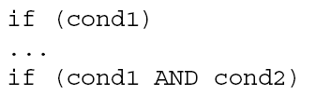
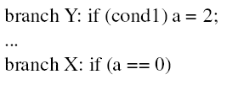
Global Branch Correlation (I)
Recently executed branch outcomes in the execution path are correlated with the outcome of the next branch
If first branch not taken, second also not taken
If first branch taken, second definitely not taken

Slide 18
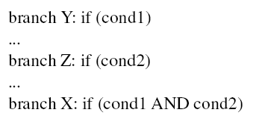
Global Branch Correlation (II)
If Y and Z both taken, then X also taken
If Y or Z not taken, then X also not taken

Slide 19
Global Branch Correlation (III)
Eqntott, SPEC’92: Generates truth table from Boolean expr.
if (aa==2) ;; B1
aa=0;
if (bb==2) ;; B2
bb=0;
if (aa!=bb) { ;; B3
….
}
If B1 is not taken (i.e., aa==0@B3) and B2 is not taken (i.e. bb=0@B3) then B3 is certainly taken

Slide 20
Capturing Global Branch Correlation
Idea: Associate branch outcomes with “global T/NT history” of all branches
Make a prediction based on the outcome of the branch the last time the same global branch history was encountered
Implementation:
Keep track of the “global T/NT history” of all branches in a register → Global History Register (GHR)
Use GHR to index into a table that recorded the outcome that was seen for each GHR value in the recent past → Pattern History Table (table of 2-bit counters)
Global history/branch predictor
Uses two levels of history (GHR + history at that GHR)
Yeh and Patt, “Two-Level Adaptive Training Branch Prediction,” MICRO 1991.

Slide 21
Two Level Global Branch Prediction
First level: Global branch history register (N bits)
The direction of last N branches
Second level: Table of saturating counters for each history entry
The direction the branch took the last time the same history was seen
Pattern History Table (PHT)
00 …. 00
1 1 ….. 1 0
00 …. 01
2
3
GHR
(global history register)
previous
branch’s
direction
00 …. 10
index
0
1
11 …. 11
Yeh and Patt, “Two-Level Adaptive Training Branch Prediction,” MICRO 1991.

Slide 22
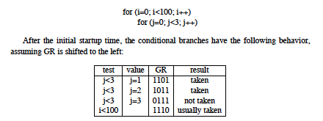
How Does the Global Predictor Work?
McFarling, “Combining Branch Predictors,” DEC WRL TR 1993.
This branch tests i
Last 4 branches test j
History: TTTN
Predict taken for i
Next history: TTNT
(shift in last outcome)
Notes:
Start with j=3, last iteration that is not taken…

Slide 23
Intel Pentium Pro Branch Predictor
Two level global branch predictor
4-bit global history register
Multiple pattern history tables (of 2 bit counters)
Which pattern history table to use is determined by lower order bits of the branch address
First widely commercially successful out-of-order execution machine

Slide 24
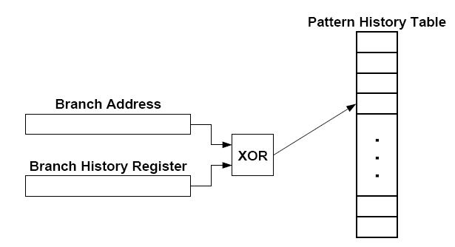
Improving Global Predictor Accuracy
Idea: Add more context information to the global predictor to take into account which branch is being predicted
Gshare predictor: GHR hashed with the Branch PC
+ More context information used for prediction
+ Better utilization of the two-bit counter array
-- Increases access latency
McFarling, “Combining Branch Predictors,” DEC WRL Tech Report, 1993.

Slide 25
Review: One-Level Branch Predictor
Direction predictor (2-bit counters)
taken?
PC + inst size
Next Fetch
Address
Program
Counter
hit?
Address of the
current instruction
target address
Cache of Target Addresses (BTB: Branch Target Buffer)

Slide 26
Two-Level Global History Branch Predictor
Which direction earlier
branches went
Direction predictor (2-bit counters)
taken?
Global branch
history
PC + inst size
Next Fetch
Address
Program
Counter
hit?
Address of the
current instruction
target address
Cache of Target Addresses (BTB: Branch Target Buffer)

Slide 27
Two-Level Gshare Branch Predictor
Which direction earlier
branches went
Direction predictor (2-bit counters)
taken?
Global branch
history
PC + inst size
Next Fetch
Address
XOR
Program
Counter
hit?
Address of the
current instruction
target address
Cache of Target Addresses (BTB: Branch Target Buffer)

Slide 28
Can We Do Better: Two-Level Prediction
Last-time and 2BC predictors exploit only “last-time” predictability for a given branch
Realization 1: A branch’s outcome can be correlated with other branches’ outcomes
Global branch correlation
Realization 2: A branch’s outcome can be correlated with past outcomes of the same branch (in addition to the outcome of the branch “last-time” it was executed)
Local branch correlation
Yeh and Patt, “Two-Level Adaptive Training Branch Prediction,” MICRO 1991.

Slide 29
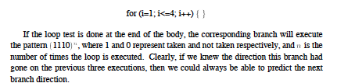
Local Branch Correlation
McFarling, “Combining Branch Predictors,” DEC WRL TR 1993.

Slide 30
More Motivation for Local History
To predict a loop branch “perfectly”, we want to identify the last iteration of the loop
By having a separate PHT entry for each local history, we can distinguish different iterations of a loop
Works for “short” loops

Slide 31
Capturing Local Branch Correlation
Idea: Have a per-branch history register
Associate the predicted outcome of a branch with “T/NT history” of the same branch
Make a prediction based on the outcome of the branch the last time the same local branch history was encountered
Called the local history/branch predictor
Uses two levels of history (Per-branch history register + history at that history register value)

Slide 32
Two Level Local Branch Prediction
First level: A set of local history registers (N bits each)
Select the history register based on the PC of the branch
Second level: Table of saturating counters for each history entry
The direction the branch took the last time the same history was seen
Pattern History Table (PHT)
00 …. 00
1 1 ….. 1 0
00 …. 01
2
3
00 …. 10
index
0
1
Local history registers
11 …. 11
Yeh and Patt, “Two-Level Adaptive Training Branch Prediction,” MICRO 1991.

Slide 33
Two-Level Local History Branch Predictor
Which directions earlier instances of *this branch* went
Direction predictor (2-bit counters)
taken?
PC + inst size
Next Fetch
Address
Program
Counter
hit?
Address of the
current instruction
target address
Cache of Target Addresses (BTB: Branch Target Buffer)

Slide 34
Can We Do Even Better?
Predictability of branches varies
Some branches are more predictable using local history
Some branches are more predictable using global
For others, a simple two-bit counter is enough
Yet for others, a single bit is enough
Observation: There is heterogeneity in predictability behavior of branches
No one-size fits all branch prediction algorithm for all branches
Idea: Exploit that heterogeneity by designing heterogeneous (hybrid) branch predictors

Slide 35
Hybrid Branch Predictors
Idea: Use more than one type of predictor (i.e., multiple algorithms) and select the “best” prediction
E.g., hybrid of 2-bit counters and global predictor
Advantages:
+ Better accuracy: different predictors are better for different branches
+ Reduced warmup time (faster-warmup predictor used until the slower-warmup predictor warms up)
Disadvantages:
-- Need “meta-predictor” or “selector” to decide which predictor to use
-- Longer access latency
McFarling, “Combining Branch Predictors,” DEC WRL Tech Report, 1993.

Slide 36
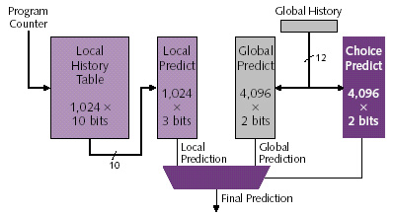
Alpha 21264 Tournament Predictor
Minimum branch penalty: 7 cycles
Typical branch penalty: 11+ cycles
48K bits of target addresses stored in I-cache
Predictor tables are reset on a context switch
Kessler, “The Alpha 21264 Microprocessor,” IEEE Micro 1999.

Slide 37
Are We Done w/ Branch Prediction?
Hybrid branch predictors work well
E.g., 90-97% prediction accuracy on average
Some “difficult” workloads still suffer, though!
E.g., gcc
Max IPC with tournament prediction: 9
Max IPC with perfect prediction: 35

Slide 38
Some Other Branch Predictor Types
Loop branch detector and predictor
Loop iteration count detector/predictor
Works well for loops with small number of iterations, where iteration count is predictable
Used in Intel Pentium M
Perceptron branch predictor
Learns the direction correlations between individual branches
Assigns weights to correlations
Jimenez and Lin, “Dynamic Branch Prediction with Perceptrons,” HPCA 2001.
Hybrid history length based predictor
Uses different tables with different history lengths
Seznec, “Analysis of the O-Geometric History Length branch predictor,” ISCA 2005.

Slide 39
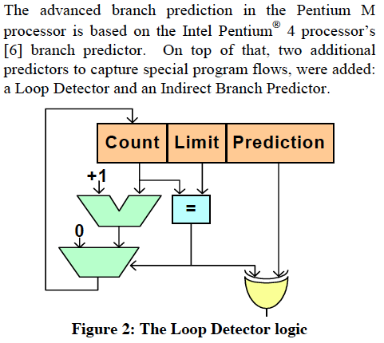
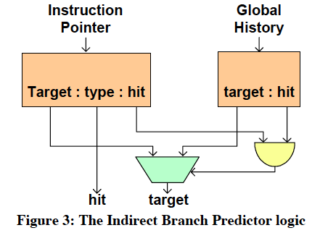
Intel Pentium M Predictors: Loop and Jump
Gochman et al.,
“The Intel Pentium M Processor: Microarchitecture and Performance,”
Intel Technology Journal, May 2003.

Slide 40
Perceptrons for Learning Linear Functions
A perceptron is a simplified model of a biological neuron
It is also a simple binary classifier
A perceptron maps an input vector X to a 0 or 1
Input = Vector X
Perceptron learns the linear function (if one exists) of how each element of the vector affects the output (stored in an internal Weight vector)
Output = Weight.X + Bias > 0
In the branch prediction context
Vector X: Branch history register bits
Output: Prediction for the current branch
Rosenblatt, “Principles of Neurodynamics: Perceptrons and the Theory of Brain Mechanisms,” 1962

Slide 41
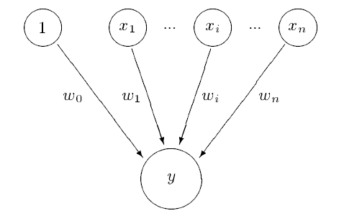
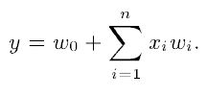
Perceptron Branch Predictor (I)
Idea: Use a perceptron to learn the correlations between branch history register bits and branch outcome
A perceptron learns a target Boolean function of N inputs
Jimenez and Lin, “Dynamic Branch Prediction with Perceptrons,” HPCA 2001.
Rosenblatt, “Principles of Neurodynamics: Perceptrons and the Theory of Brain Mechanisms,” 1962
Each branch associated with a perceptron
A perceptron contains a set of weights wi
Each weight corresponds to a bit in
the GHR
How much the bit is correlated with the
direction of the branch
→ Positive correlation: large + weight
→ Negative correlation: large - weight
Prediction:
→ Express GHR bits as 1 (T) and -1 (NT)
→ Take dot product of GHR and weights
→ If output > 0, predict taken

Slide 42
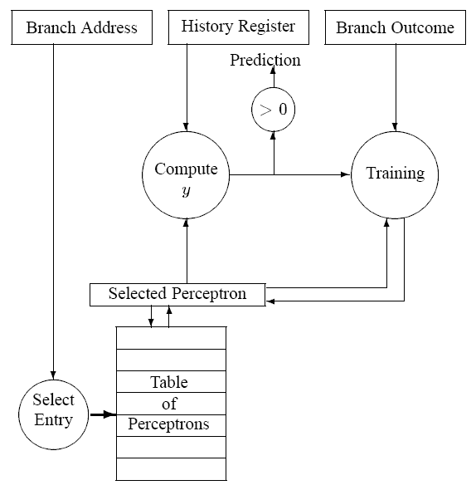
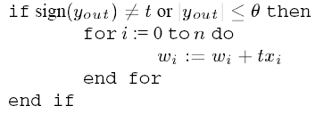
Perceptron Branch Predictor (II)
Prediction function:
Dot product of GHR
and perceptron weights
Output
compared
to 0
Bias weight
(bias of branch, independent of
the history)
Training function:

Slide 43
Perceptron Branch Predictor (III)
Advantages
+ More sophisticated learning mechanism → better accuracy
Disadvantages
-- Hard to implement (adder tree to compute perceptron output)
-- Can learn only linearly-separable functions
e.g., cannot learn XOR type of correlation between 2 history bits and branch outcome
A successful example of use of machine learning in processor design

Slide 44
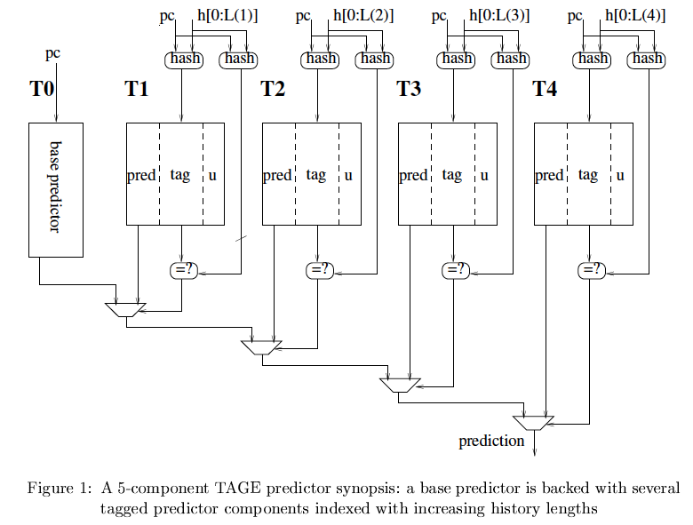
Prediction Using Multiple History Lengths
Observation: Different branches require different history lengths for better prediction accuracy
Idea: Have multiple PHTs indexed with GHRs with different history lengths and intelligently allocate PHT entries to different branches
Seznec and Michaud, “A case for (partially) tagged Geometric History Length
Branch Prediction,” JILP 2006.

Slide 45
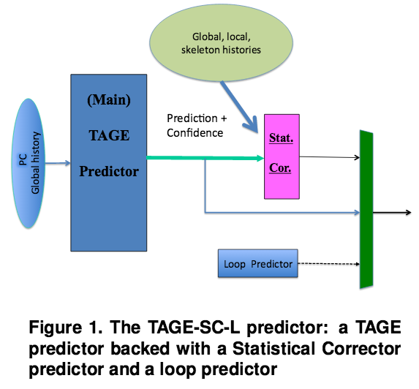
State of the Art in Branch Prediction
See the Branch Prediction Championship
https://www.jilp.org/cbp2016/program.html
Andre Seznec,
“TAGE-SC-L branch predictors,”
CBP 2014.
Andre Seznec,
“TAGE-SC-L branch predictors
again,” CBP 2016.

Slide 46
Branch Confidence Estimation
Idea: Estimate if the prediction is likely to be correct
i.e., estimate how “confident” you are in the prediction
Why?
Could be very useful in deciding how to speculate:
What predictor/PHT to choose/use
Whether to keep fetching on this path
Whether to switch to some other way of handling the branch, e.g. dual-path execution (eager execution) or dynamic predication
…
Jacobsen et al., “Assigning Confidence to Conditional Branch Predictions,” MICRO 1996.

Slide 47
Other Ways of Handling Branches

Slide 48
How to Handle Control Dependences
Critical to keep the pipeline full with correct sequence of dynamic instructions.
Potential solutions if the instruction is a control-flow instruction:
Stall the pipeline until we know the next fetch address
Guess the next fetch address (branch prediction)
Employ delayed branching (branch delay slot)
Do something else (fine-grained multithreading)
Eliminate control-flow instructions (predicated execution)
Fetch from both possible paths (if you know the addresses of both possible paths) (multipath execution)

Slide 49
Delayed Branching (I)
Change the semantics of a branch instruction
Branch after N instructions
Branch after N cycles
Idea: Delay the execution of a branch. N instructions (delay slots) that come after the branch are always executed regardless of branch direction.
Problem: How do you find instructions to fill the delay slots?
Branch must be independent of delay slot instructions
Unconditional branch: Easier to find instructions to fill the delay slot
Conditional branch: Condition computation should not depend on instructions in delay slots → difficult to fill the delay slot

Slide 50
Delayed Branching (II)
Normal code:
Timeline:
Delayed branch code:
Timeline:
A
if
ex
A
if
ex
B
C
C
A
BC X
A
BC X
B
A
B
C
A
D
C
B
D
BC
C
E
BC
C
E
B
BC
F
--
BC
F
G
B
X:
G
G
--
X:
G
6 cycles
5 cycles

Slide 51
Fancy Delayed Branching (III)
Delayed branch with squashing
In SPARC
Semantics: If the branch falls through (i.e., it is not taken), the delay slot instruction is not executed
Why could this help?
Normal code:
Delayed branch code:
Delayed branch w/ squashing:
X:
A
X:
A
A
B
B
X:
B
C
C
C
BC X
BC X
BC X
D
NOP
A
E
D
D
E
E

Slide 52
Delayed Branching (IV)
Advantages:
+ Keeps the pipeline full with useful instructions in a simple way assuming
1. Number of delay slots == number of instructions to keep the pipeline full before the branch resolves
2. All delay slots can be filled with useful instructions
Disadvantages:
-- Not easy to fill the delay slots (even with a 2-stage pipeline)
1. Number of delay slots increases with pipeline depth, superscalar execution width
2. Number of delay slots should be variable with variable latency operations. Why?
-- Ties ISA semantics to hardware implementation
-- SPARC, MIPS, HP-PA: 1 delay slot
-- What if pipeline implementation changes with the next design?

Slide 53
Digital Design & Computer Arch. Lecture 17: Branch Prediction II
Prof. Onur Mutlu
ETH Zürich
Spring 2020
24 April 2020

Slide 54
We did not cover the following slides. They are for your benefit.

Slide 55
An Aside: Filling the Delay Slot
reordering data
independent
(RAW, WAW,
WAR)
instructions
does not change
program semantics
Safe?
within same
basic block
For correctness:
add a new instruction
to the not-taken path?
For correctness:
add a new instruction
to the taken path?
[Based on original figure from P&H CO&D, COPYRIGHT 2004 Elsevier. ALL RIGHTS RESERVED.]

Slide 56
How to Handle Control Dependences
Critical to keep the pipeline full with correct sequence of dynamic instructions.
Potential solutions if the instruction is a control-flow instruction:
Stall the pipeline until we know the next fetch address
Guess the next fetch address (branch prediction)
Employ delayed branching (branch delay slot)
Do something else (fine-grained multithreading)
Eliminate control-flow instructions (predicated execution)
Fetch from both possible paths (if you know the addresses of both possible paths) (multipath execution)

Slide 57
Predicate Combining (not Predicated Execution)
Complex predicates are converted into multiple branches
if ((a == b) && (c < d) && (a > 5000)) { … }
3 conditional branches
Problem: This increases the number of control dependencies
Idea: Combine predicate operations to feed a single branch instruction instead of having one branch for each
Predicates stored and operated on using condition registers
A single branch checks the value of the combined predicate
+ Fewer branches in code → fewer mipredictions/stalls
-- Possibly unnecessary work
-- If the first predicate is false, no need to compute other predicates
Condition registers exist in IBM RS6000 and the POWER architecture

Slide 58
Predication (Predicated Execution)
Idea: Convert control dependence to data dependence
Simple example: Suppose we had a Conditional Move instruction…
CMOV condition, R1 ← R2
R1 = (condition == true) ? R2 : R1
Employed in most modern ISAs (x86, Alpha)
Code example with branches vs. CMOVs
if (a == 5) {b = 4;} else {b = 3;}
CMPEQ condition, a, 5;
CMOV condition, b ← 4;
CMOV !condition, b ← 3;

Slide 59
Predication (Predicated Execution)
Idea: Compiler converts control dependence into data dependence → branch is eliminated
Each instruction has a predicate bit set based on the predicate computation
Only instructions with TRUE predicates are committed (others turned into NOPs)
(normal branch code)
(predicated code)
A
T
N
A
if (cond) {
b = 0;
}
else {
b = 1;
}
C
B
B
C
D
D
A
p1 = (cond)
branch p1, TARGET
A
p1 = (cond)
(!p1) mov b, 1
(p1) mov b, 0
B
B
mov b, 1
jmp JOIN
C
C
TARGET:
mov b, 0
D
add x, b, 1
D
add x, b, 1

Slide 60
Predicated Execution References
Allen et al., “Conversion of control dependence to data dependence,” POPL 1983.
Kim et al., “Wish Branches: Combining Conditional Branching and Predication for Adaptive Predicated Execution,” MICRO 2005.

Slide 61
Conditional Move Operations
Very limited form of predicated execution
CMOV R1 ← R2
R1 = (ConditionCode == true) ? R2 : R1
Employed in most modern ISAs (x86, Alpha)

Slide 62
Predicated Execution (II)
Predicated execution can be high performance and energy-efficient
Predicated Execution
A
Fetch Decode Rename Schedule RegisterRead Execute
C
B
F
E
E
F
D
F
D
E
F
C
A
B
A
E
F
C
D
B
F
D
E
B
C
A
F
E
C
D
A
B
E
D
B
C
A
D
C
A
B
C
B
A
B
A
E
A
A
F
D
E
F
C
D
E
B
C
D
A
B
A
C
D
A
B
B
A
C
C
B
nop
Branch Prediction
D
Fetch Decode Rename Schedule RegisterRead Execute
F
E
D
B
A
E
Pipeline flush!!
F

Slide 63
Predicated Execution
Eliminates branches → enables straight line code (i.e., larger basic blocks in code)
Advantages
Eliminates hard-to-predict branches
Always-not-taken prediction works better (no branches)
Compiler has more freedom to optimize code (no branches)
control flow does not hinder inst. reordering optimizations
code optimizations hindered only by data dependencies
Disadvantages
Useless work: some instructions fetched/executed but discarded (especially bad for easy-to-predict branches)
Requires additional ISA (and hardware) support
Can we eliminate all branches this way?

Slide 64
Predicated Execution vs. Branch Prediction
+ Eliminates mispredictions for hard-to-predict branches
+ No need for branch prediction for some branches
+ Good if misprediction cost > useless work due to predication
-- Causes useless work for branches that are easy to predict
-- Reduces performance if misprediction cost < useless work
-- Adaptivity: Static predication is not adaptive to run-time branch behavior. Branch behavior changes based on input set, program phase, control-flow path.

Slide 65
Predicated Execution in Intel Itanium
Each instruction can be separately predicated
64 one-bit predicate registers
each instruction carries a 6-bit predicate field
An instruction is effectively a NOP if its predicate is false
cmp
p1 p2 ←cmp
br
p2
else1
else1
p1
then1
join1
else2
p1
then2
br
p2
else2
then1
join2
then2
join1
join2

Slide 66
Conditional Execution in the ARM ISA
Almost all ARM instructions could include an optional condition code.
Prior to ARM v8
An instruction with a condition code is executed only if the condition code flags in the CPSR meet the specified condition.

Slide 67
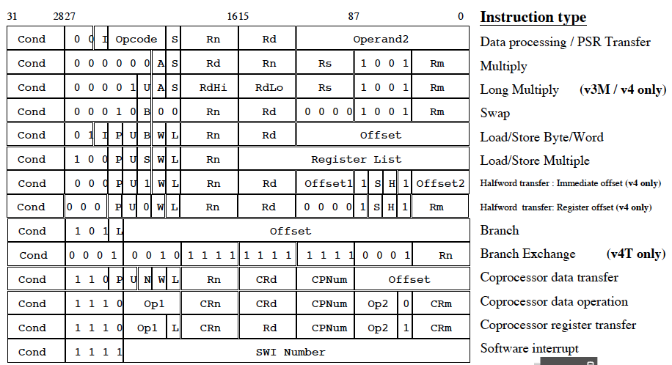
Conditional Execution in ARM ISA

Slide 68
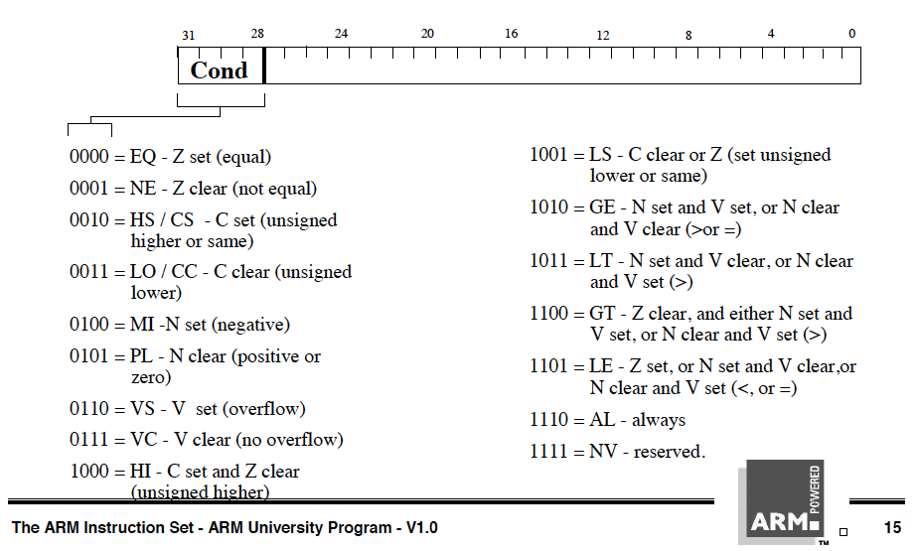
Conditional Execution in ARM ISA

Slide 69
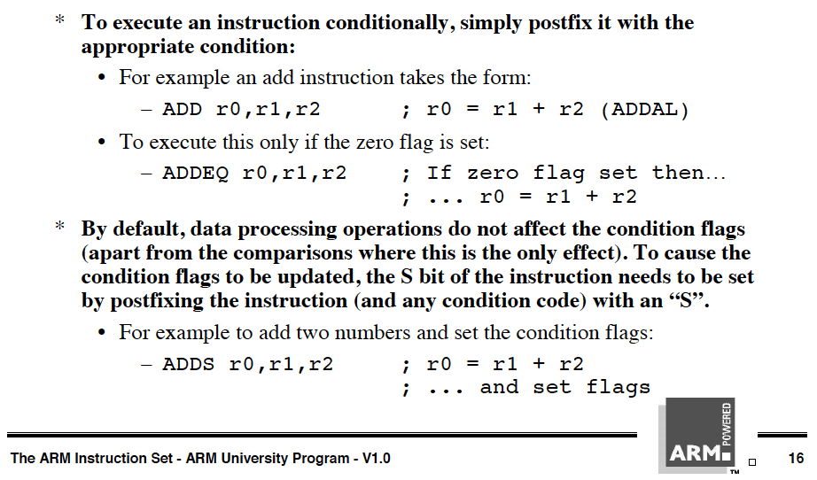
Conditional Execution in ARM ISA

Slide 70
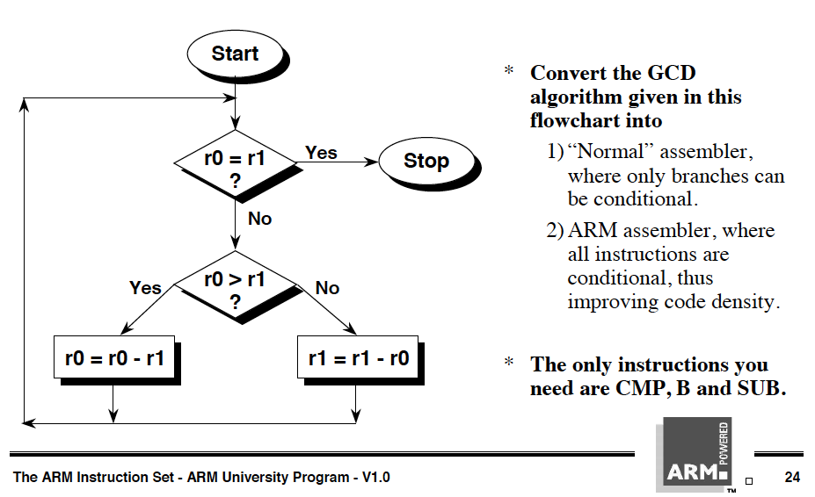
Conditional Execution in ARM ISA

Slide 71
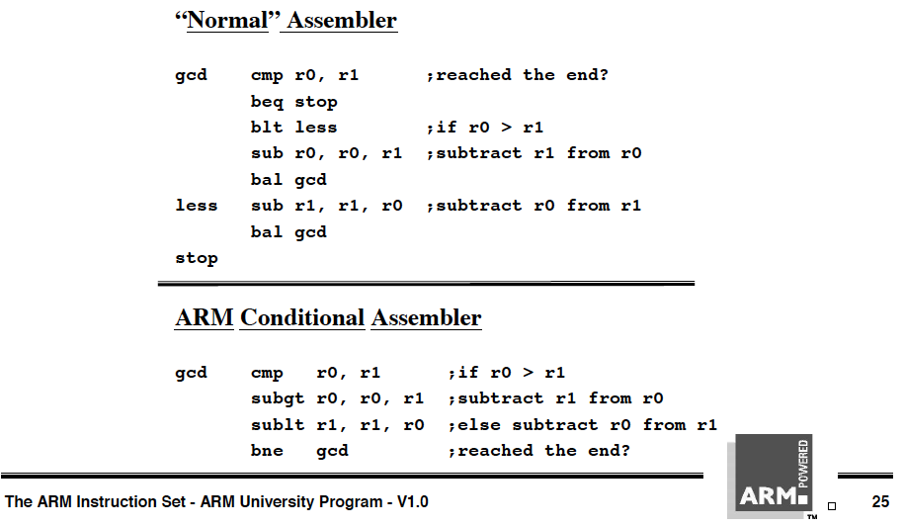
Conditional Execution in ARM ISA

Slide 72
How to Handle Control Dependences
Critical to keep the pipeline full with correct sequence of dynamic instructions.
Potential solutions if the instruction is a control-flow instruction:
Stall the pipeline until we know the next fetch address
Guess the next fetch address (branch prediction)
Employ delayed branching (branch delay slot)
Do something else (fine-grained multithreading)
Eliminate control-flow instructions (predicated execution)
Fetch from both possible paths (if you know the addresses of both possible paths) (multipath execution)

Slide 73
Multi-Path Execution
Idea: Execute both paths after a conditional branch
For all branches: Riseman and Foster, “The inhibition of potential parallelism by conditional jumps,” IEEE Transactions on Computers, 1972.
For a hard-to-predict branch: Use dynamic confidence estimation
Advantages:
+ Improves performance if misprediction cost > useless work
+ No ISA change needed
Disadvantages:
-- What happens when the machine encounters another hard-to-predict branch? Execute both paths again?
-- Paths followed quickly become exponential
-- Each followed path requires its own context (registers, PC, GHR)
-- Wasted work (and reduced performance) if paths merge

Slide 74
Dual-Path Execution versus Predication
Dual-path
Predicated Execution
A
Hard to predict
path 1
path 2
path 1
path 2
C
B
C
B
C
B
D
D
D
CFMerge
CFMerge
D
E
E
E
E
F
F
F
F

Slide 75
Handling Other Types of Branches

Slide 76
Remember: Branch Types
Type | Direction at fetch time | Number of possible next fetch addresses? | When is next fetch address resolved?
Conditional | Unknown | 2 | Execution (register dependent)
Unconditional | Always taken | 1 | Decode (PC + offset)
Call | Always taken | 1 | Decode (PC + offset)
Return | Always taken | Many | Execution (register dependent)
Indirect | Always taken | Many | Execution (register dependent)
How can we predict an indirect branch with many target addresses?

Slide 77
Call and Return Prediction
Call X
…
Call X
…
Call X
…
Return
Return
Return
Direct calls are easy to predict
Always taken, single target
Call marked in BTB, target predicted by BTB
Returns are indirect branches
A function can be called from many points in code
A return instruction can have many target addresses
Next instruction after each call point for the same function
Observation: Usually a return matches a call
Idea: Use a stack to predict return addresses (Return Address Stack)
A fetched call: pushes the return (next instruction) address on the stack
A fetched return: pops the stack and uses the address as its predicted target
Accurate most of the time: 8-entry stack → > 95% accuracy

Slide 78
Indirect Branch Prediction (I)
Register-indirect branches have multiple targets
Used to implement
Switch-case statements
Virtual function calls
Jump tables (of function pointers)
Interface calls
A
A
R1 = MEM[R2]
branch R1
N
br.cond TARGET
T
?
TARG
A+1
α
β
δ
ρ
Conditional (Direct) Branch
Indirect Jump

Slide 79
Indirect Branch Prediction (II)
No direction prediction needed
Idea 1: Predict the last resolved target as the next fetch address
+ Simple: Use the BTB to store the target address
-- Inaccurate: 50% accuracy (empirical). Many indirect branches switch between different targets
Idea 2: Use history based target prediction
E.g., Index the BTB with GHR XORed with Indirect Branch PC
Chang et al., “Target Prediction for Indirect Jumps,” ISCA 1997.
+ More accurate
-- An indirect branch maps to (too) many entries in BTB
-- Conflict misses with other branches (direct or indirect)
-- Inefficient use of space if branch has few target addresses

Slide 80
Intel Pentium M Indirect Branch Predictor
Gochman et al.,
“The Intel Pentium M Processor: Microarchitecture and Performance,”
Intel Technology Journal, May 2003.

Slide 81
Issues in Branch Prediction (I)
Need to identify a branch before it is fetched
How do we do this?
BTB hit → indicates that the fetched instruction is a branch
BTB entry contains the “type” of the branch
Pre-decoded “branch type” information stored in the instruction cache identifies type of branch
What if no BTB?
Bubble in the pipeline until target address is computed
E.g., IBM POWER4

Slide 82
Latency of Branch Prediction
Latency: Prediction is latency critical
Need to generate next fetch address for the next cycle
Bigger, more complex predictors are more accurate but slower
PC + inst size
BTB target
Next Fetch
Address
Return Address Stack target
Indirect Branch Predictor target
Resolved target from Backend
???

